Slide 1
Unit 4 Binary Tree and Graphs
By : Prof Deepti Bhirud

Slide 2
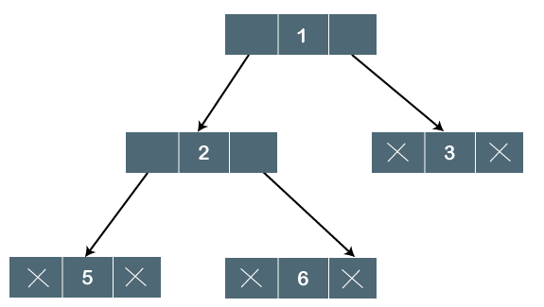
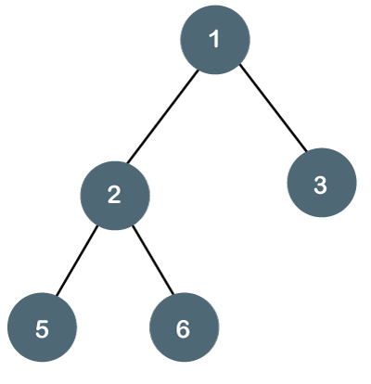
Binary Tree
The Binary tree means that the node can have maximum two children.
Here, binary name itself suggests that 'two';
therefore, each node can have either 0, 1 or 2 children.
The above tree is a binary tree because each node contains the utmost two children.
The logical representation of the above tree is given below:
In the above tree, node 1 contains two pointers, i.e., left and a right pointer pointing to the left and right node respectively. The node 2 contains both the nodes (left and right node); therefore, it has two pointers (left and right). The nodes 3, 5 and 6 are the leaf nodes, so all these nodes contain NULL pointer on both left and right parts.

Slide 3
Properties of Binary Tree
The height of the tree is defined as the longest path from the root node to the leaf node. The tree which is shown above has a height equal to 3. Therefore, the maximum number of nodes at height 3 is equal to (1+2+4+8) = 15.
The minimum number of nodes possible at height h is equal to h+1.
Types of Binary Tree
There are four types of Binary tree:
Full/ proper/ strict Binary tree
Complete Binary tree
Perfect Binary tree
Degenerate Binary tree
Balanced Binary tree

Slide 4

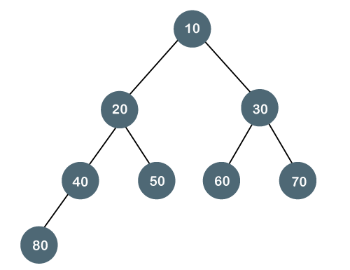
Full/ proper/ strict Binary tree
The full binary tree is also known as a strict binary tree. The tree can only be considered as the full binary tree if each node must contain either 0 or 2 children. The full binary tree can also be defined as the tree in which each node must contain 2 children except the leaf nodes.
In this tree, we can observe that each node is either containing
zero or two children; therefore, it is a Full Binary tree.
2. The complete binary tree is a tree in which all the nodes are completely filled except the last level. In the last level, all the nodes must be as left as possible. In a complete binary tree, the nodes should be added from the left.

Slide 5
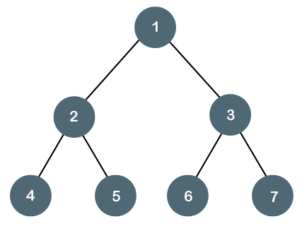
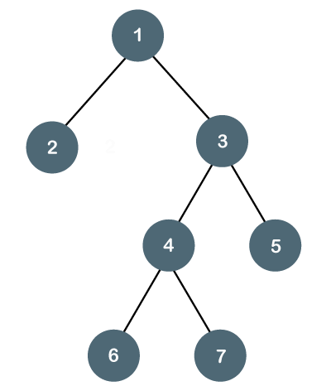
Perfect Binary Tree
A tree is a perfect binary tree if all the internal nodes have 2 children, and all the leaf nodes are at the same level.
The below tree is not a perfect binary tree because all the leaf nodes are not at the same level.

Slide 6
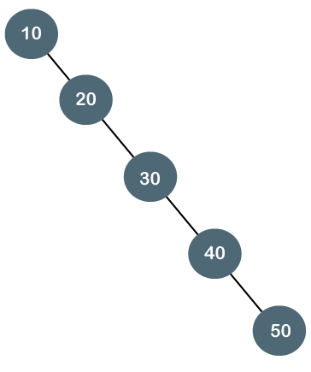
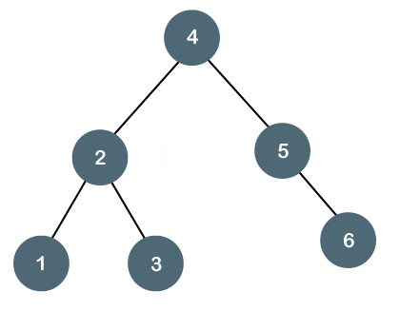
Degenerate Binary Tree
The degenerate binary tree is a tree in which all the internal nodes have only one children.
Let's understand the Degenerate binary tree through examples.
The beside tree is a degenerate binary tree because all the nodes
have only one child.
It is also known as a right-skewed tree as all the nodes have a right child only.
Balanced Binary Tree
The balanced binary tree is a tree in which both the left and right trees differ by atmost 1.

Slide 7
Binary tree implementation
A Binary tree is implemented with the help of pointers. The first node in the tree is represented by the root pointer. Each node in the tree consists of three parts, i.e., data, left pointer and right pointer. To create a binary tree, we first need to create the node. We will create the node of user-defined as shown below:
struct node
{
int data,
struct node *left, *right;
}
In the above structure, data is the value, left pointer contains the address of the left node, and right pointer contains the address of the right node.

Slide 8
void main()
{
struct node *root;
root = create();
}
struct node *create()
{
struct node *temp;
int data;
temp = (struct node *)malloc(sizeof(struct node));
printf("Press 0 to exit");
printf("\n Press 1 for new node");
printf("Enter your choice : ");
scanf("%d", &choice);
if(choice==0)
{
return 0;
}
else
{
printf("Enter the data:");
scanf("%d", &data);
temp->data = data;
printf("Enter the left child of %d", data);
temp->left = create();
printf("Enter the right child of %d", data);
temp->right = create();
return temp;
}
}

Slide 9
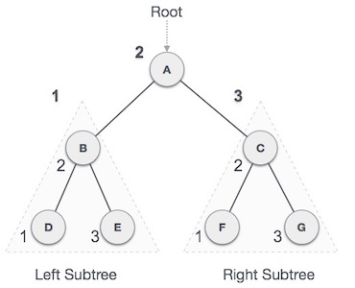
The above code is calling the create() function recursively and creating new node on each recursive call. When all the nodes are created, then it forms a binary tree structure. The process of visiting the nodes is known as tree traversal.
There are three types traversals used to visit a node:
Inorder traversal
Preorder traversal
Postorder traversal
1. In-order Traversal
In this traversal method, the left subtree is visited first, then the root and later the right sub-tree. We should always remember that every node may represent a subtree itself.
If a binary tree is traversed in-order, the output will produce sorted key values in an ascending order.
We start from A, and following in-order traversal, we move to its left subtree B. B is also traversed in-order. The process goes on until all the nodes are visited. The output of inorder traversal of this tree will be −
D → B → E → A → F → C → G

Slide 10
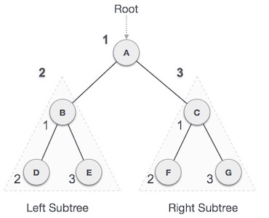
Until all nodes are traversed −
Step 1 − Recursively traverse left subtree.
Step 2 − Visit root node.
Step 3 − Recursively traverse right subtree.
Pre-order Traversal
In this traversal method, the root node is visited first, then the left subtree and finally the right subtree.
We start from A, and following pre-order traversal, we first visit A itself and then move to its left subtree B. B is also traversed pre-order. The process goes on until all the nodes are visited. The output of pre-order traversal of this tree will be −
A → B → D → E → C → F → G
Algorithm
Until all nodes are traversed −
Step 1 − Visit root node.
Step 2 − Recursively traverse left subtree.
Step 3 − Recursively traverse right subtree.

Slide 11
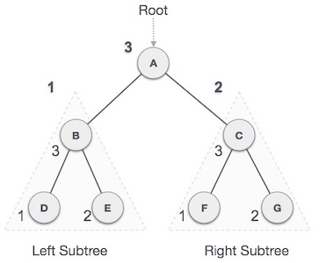
Post-order Traversal
In this traversal method, the root node is visited last, hence the name.
First we traverse the left subtree, then the right subtree and finally the root node.
We start from A, and following Post-order traversal, we first visit the left subtree B. B is also traversed post-order. The process goes on until all the nodes are visited. The output of post-order traversal of this tree will be −
D → E → B → F → G → C → A
Algorithm
Until all nodes are traversed −
Step 1 − Recursively traverse left subtree.
Step 2 − Recursively traverse right subtree.
Step 3 − Visit root node.

Slide 12
void pre_order_traversal(struct node* root) {
if(root != NULL) {
printf("%d ",root->data);
pre_order_traversal(root->leftChild);
pre_order_traversal(root->rightChild);
}
}
void inorder_traversal(struct node* root) {
if(root != NULL) {
inorder_traversal(root->leftChild);
printf("%d ",root->data);
inorder_traversal(root->rightChild);
}
}
void post_order_traversal(struct node* root) {
if(root != NULL) {
post_order_traversal(root->leftChild);
post_order_traversal(root->rightChild);
printf("%d ", root->data);
}
}

Slide 13
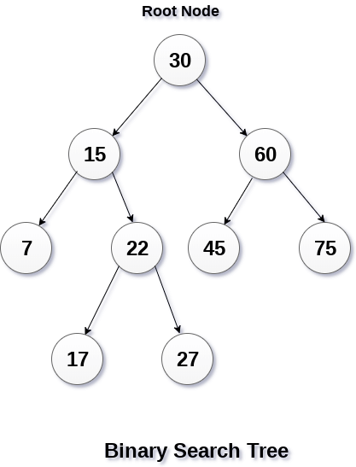
Binary Search Tree
Binary Search tree can be defined as a class of binary trees, in which the nodes are arranged in a specific order. This is also called ordered binary tree.
In a binary search tree, the value of all the nodes in the left sub-tree is less than the value of the root.
Similarly, value of all the nodes in the right sub-tree is greater than or equal to the value of the root.
This rule will be recursively applied to all the left and right sub-trees of the root.

Slide 14
Advantages of using binary search tree
Searching become very efficient in a binary search tree since, we get a hint at each step, about which sub-tree contains the desired element.
The binary search tree is considered as efficient data structure in compare to arrays and linked lists. In searching process, it removes half sub-tree at every step. Searching for an element in a binary search tree takes o(log₂n) time. In worst case, the time it takes to search an element is 0(n).
It also speed up the insertion and deletion operations as compare to that in array and linked list.
Create the binary search tree using the following data elements.
43, 10, 79, 90, 12, 54, 11, 9, 50
Insert 43 into the tree as the root of the tree.
Read the next element, if it is lesser than the root node element, insert it as the root of the left sub-tree.
Otherwise, insert it as the root of the right of the right sub-tree.
The process of creating BST by using the given elements, is shown in the image below.

Slide 15
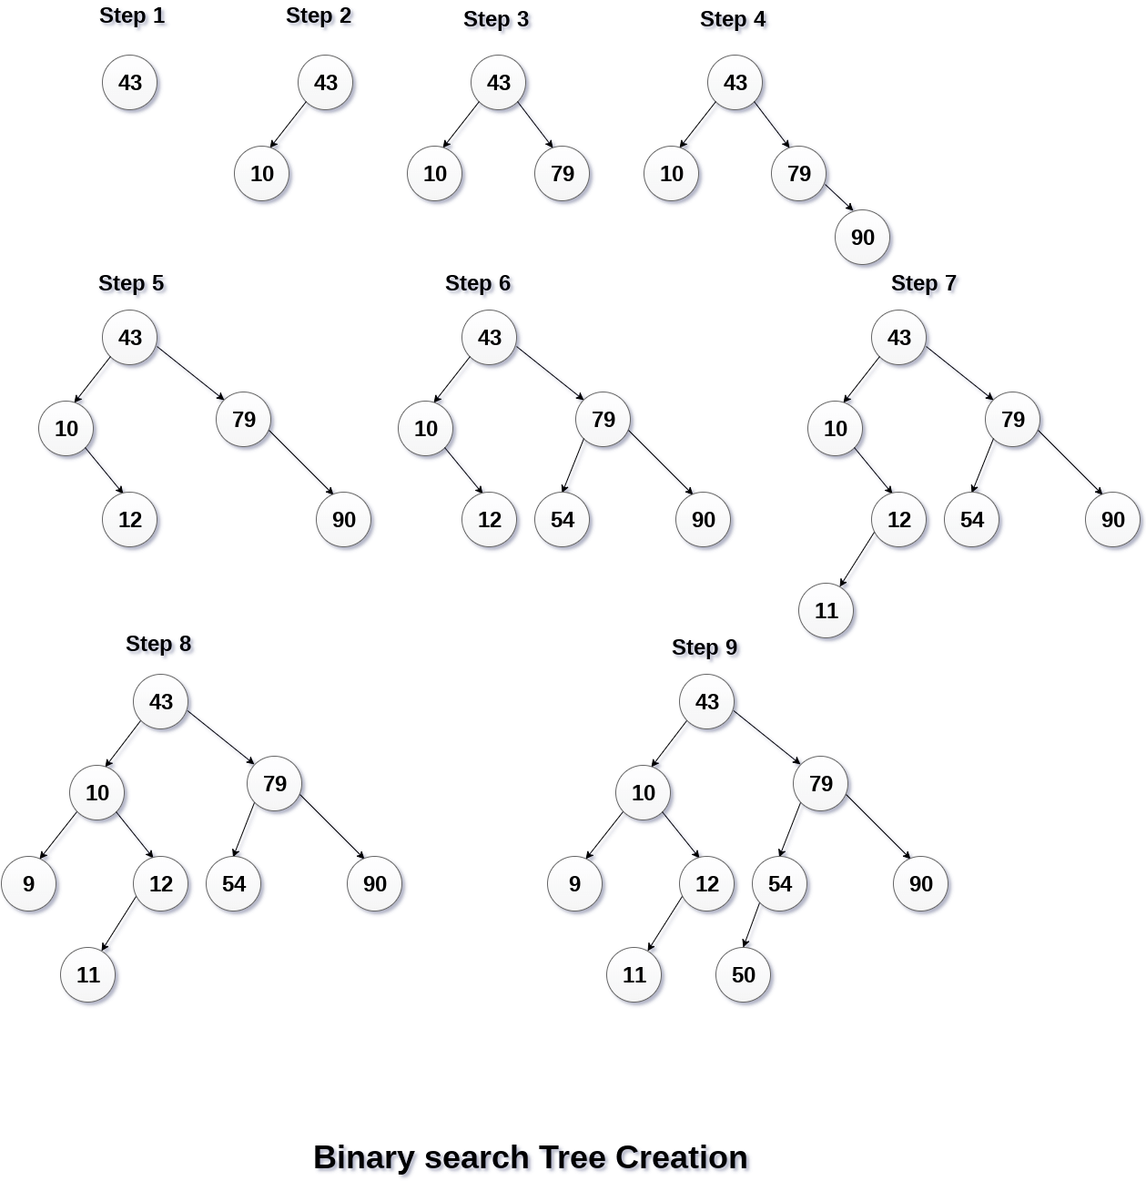

Slide 16
struct node{
int data;
struct node *left;
struct node *right;
};
struct node *root= NULL;
//createNode() will create a new node
struct node* createNode(int data){
//Create a new node
struct node *newNode = (struct node*)malloc(sizeof(struct node));
//Assign data to newNode, set left and right children to NULL
newNode->data= data;
newNode->left = NULL;
newNode->right = NULL;
return newNode;
}

Slide 17
void insert(int data) {
//Create a new node
struct node *newNode = createNode(data);
//Check whether tree is empty
if(root == NULL){
root = newNode;
return;
}
else {
//current node point to root of the tree
struct node *current = root, *parent = NULL;
while(true) {
//parent keep track of the parent node of current node.
parent = current;
//If data is less than current's data, node will be inserted to the left of tree
if(data < current->data) {
current = current->left;
if(current == NULL) {
parent->left = newNode;
return;
}
}
//If data is greater than current's data, node will be inserted to the right of tree
else {
current = current->right;
if(current == NULL) {
parent->right = newNode;
return;
}
}
}
}
}

Slide 18
struct node* deleteNode(struct node *node, int value) {
if(node == NULL){
return NULL;
}
else {
//value is less than node's data then, search the value in left subtree
if(value < node->data)
node->left = deleteNode(node->left, value);
//value is greater than node's data then, search the value in right subtree
else if(value > node->data)
node->right = deleteNode(node->right, value);
//If value is equal to node's data that is, we have found the node to be deleted
else {
//If node to be deleted has no child then, set the node to NULL
if(node->left == NULL && node->right == NULL)
node = NULL;
//If node to be deleted has only one right child
else if(node->left == NULL) {
node = node->right;
}
//If node to be deleted has only one left child
else if(node->right == NULL) {
node = node->left;
}
//If node to be deleted has two children node
else {
//then find the minimum node from right subtree
struct node *temp = minNode(node->right);
//Exchange the data between node and temp
node->data = temp->data;
//Delete the node duplicate node from right subtree
node->right = deleteNode(node->right, temp->data);
}
}
return node;
}
}

